Slide 1
Ensemble Methods
Jeff Macaluso
@MacalusoJeff

Slide 2
Slides & Notebook on GitHub
www.github.com/JeffMacaluso/Talks/fillthisin

Slide 3




About Me

Slide 4
What are ensemble methods and why should I care?

Slide 5
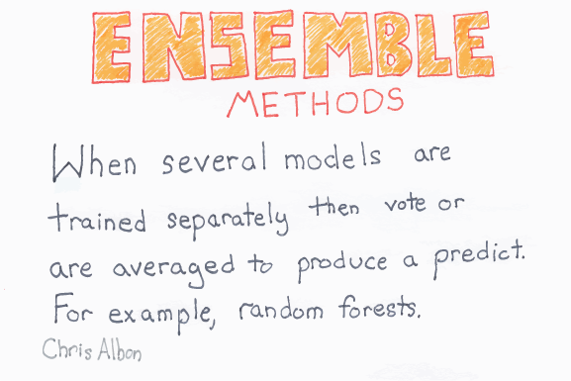

Slide 6
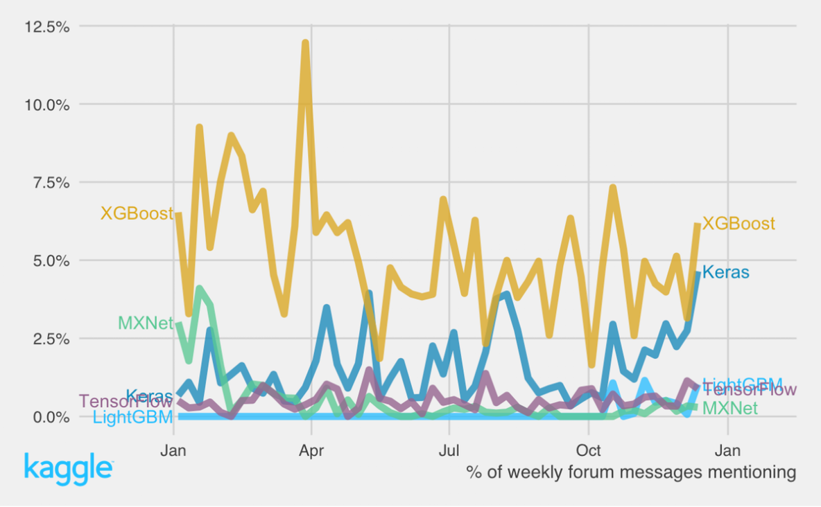
Kaggle: 2016

Slide 7
Why not use XGBoost & Keras for everything?
Interpretability
Computational cost
Training
Inference

Slide 8

No Free Lunch Theorem
“There is no one model that works best for every problem”

Slide 9
However…
Interpretability
Can obtain “relative importance” of features
Computational Cost
Can parallelize some ensemble algorithms

Slide 10
More on Ensemble Methods

Slide 11
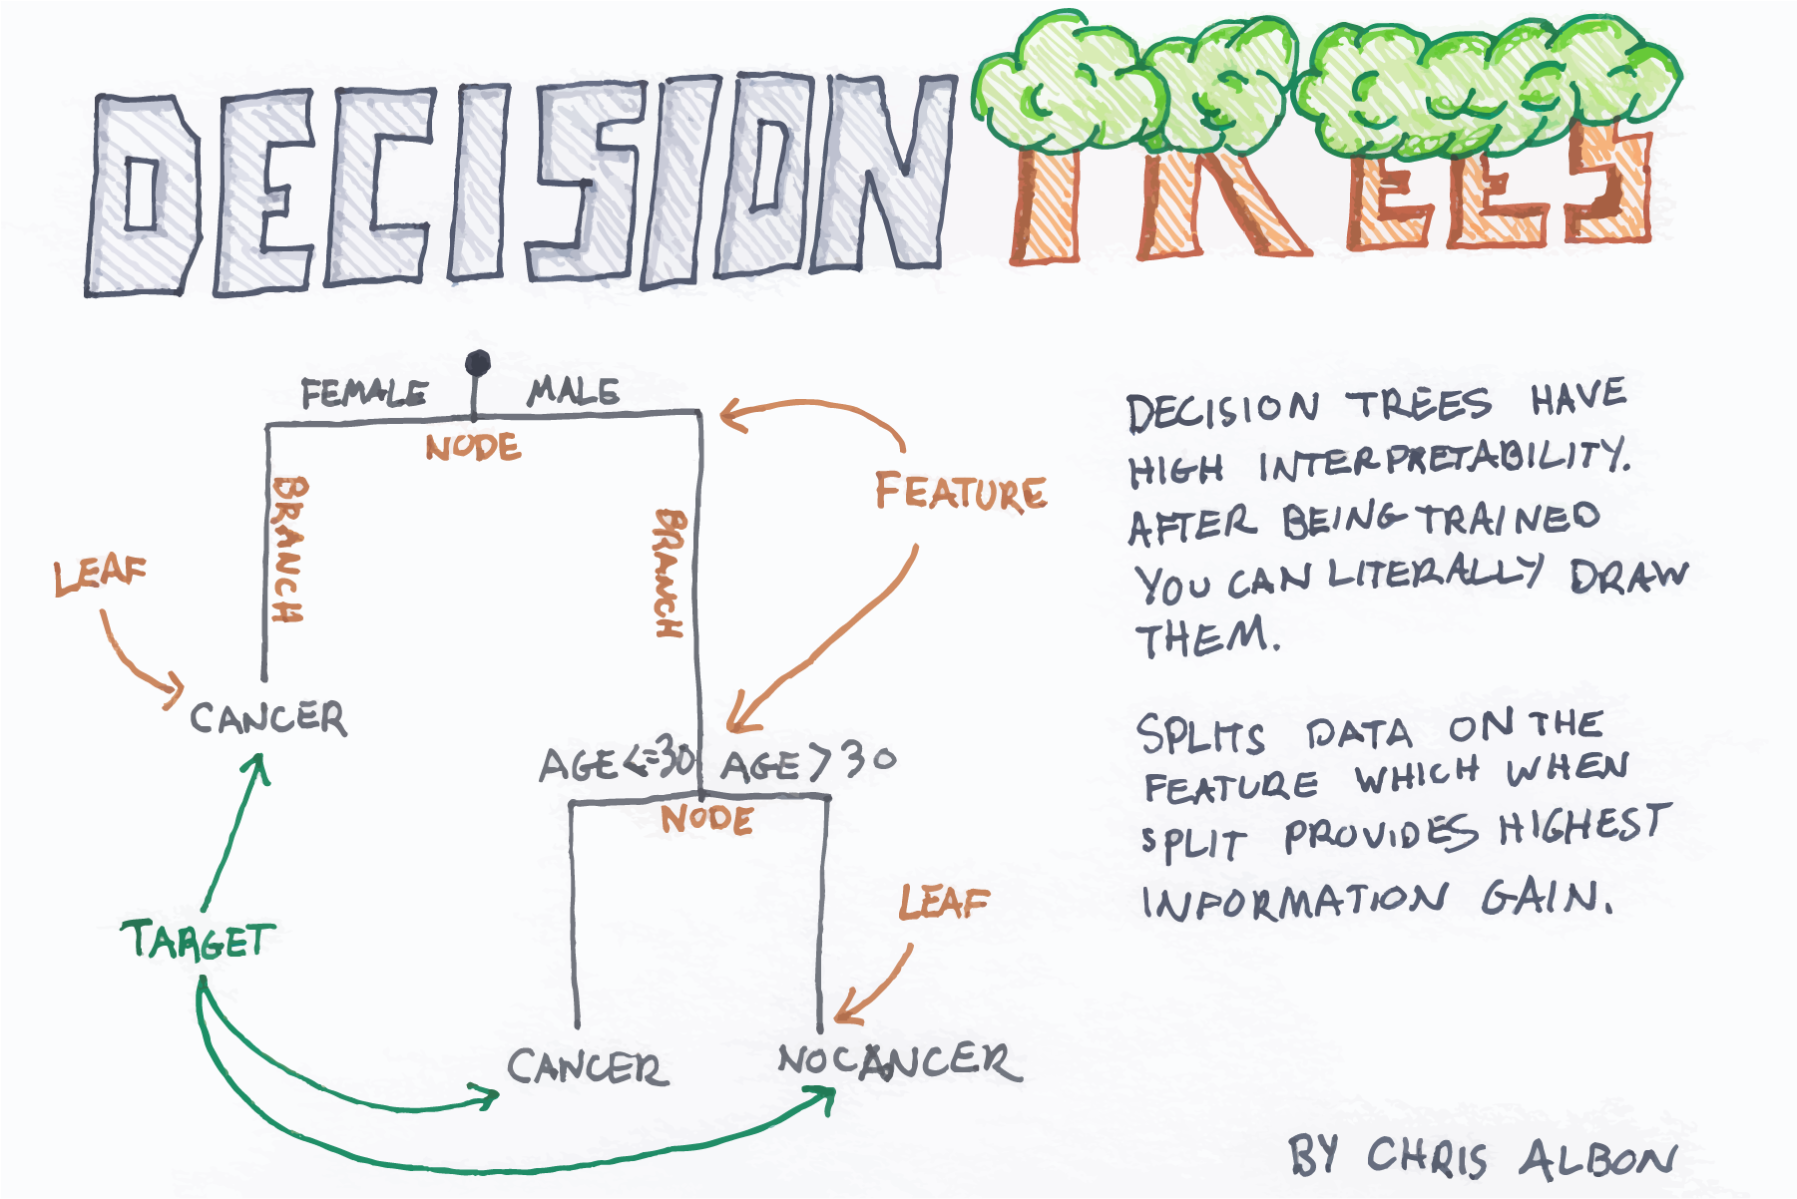

Slide 12
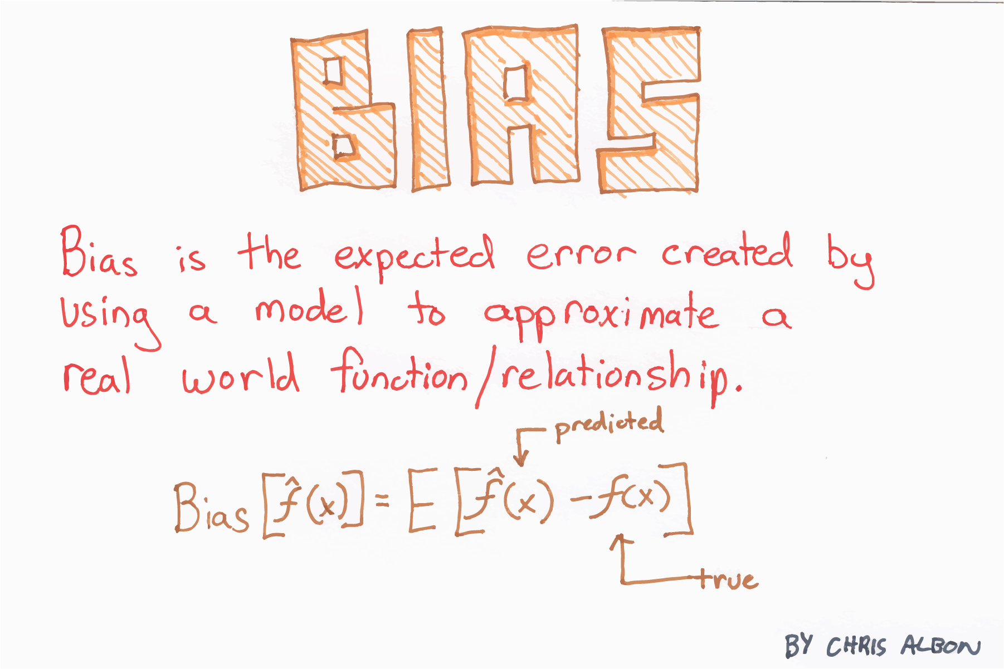
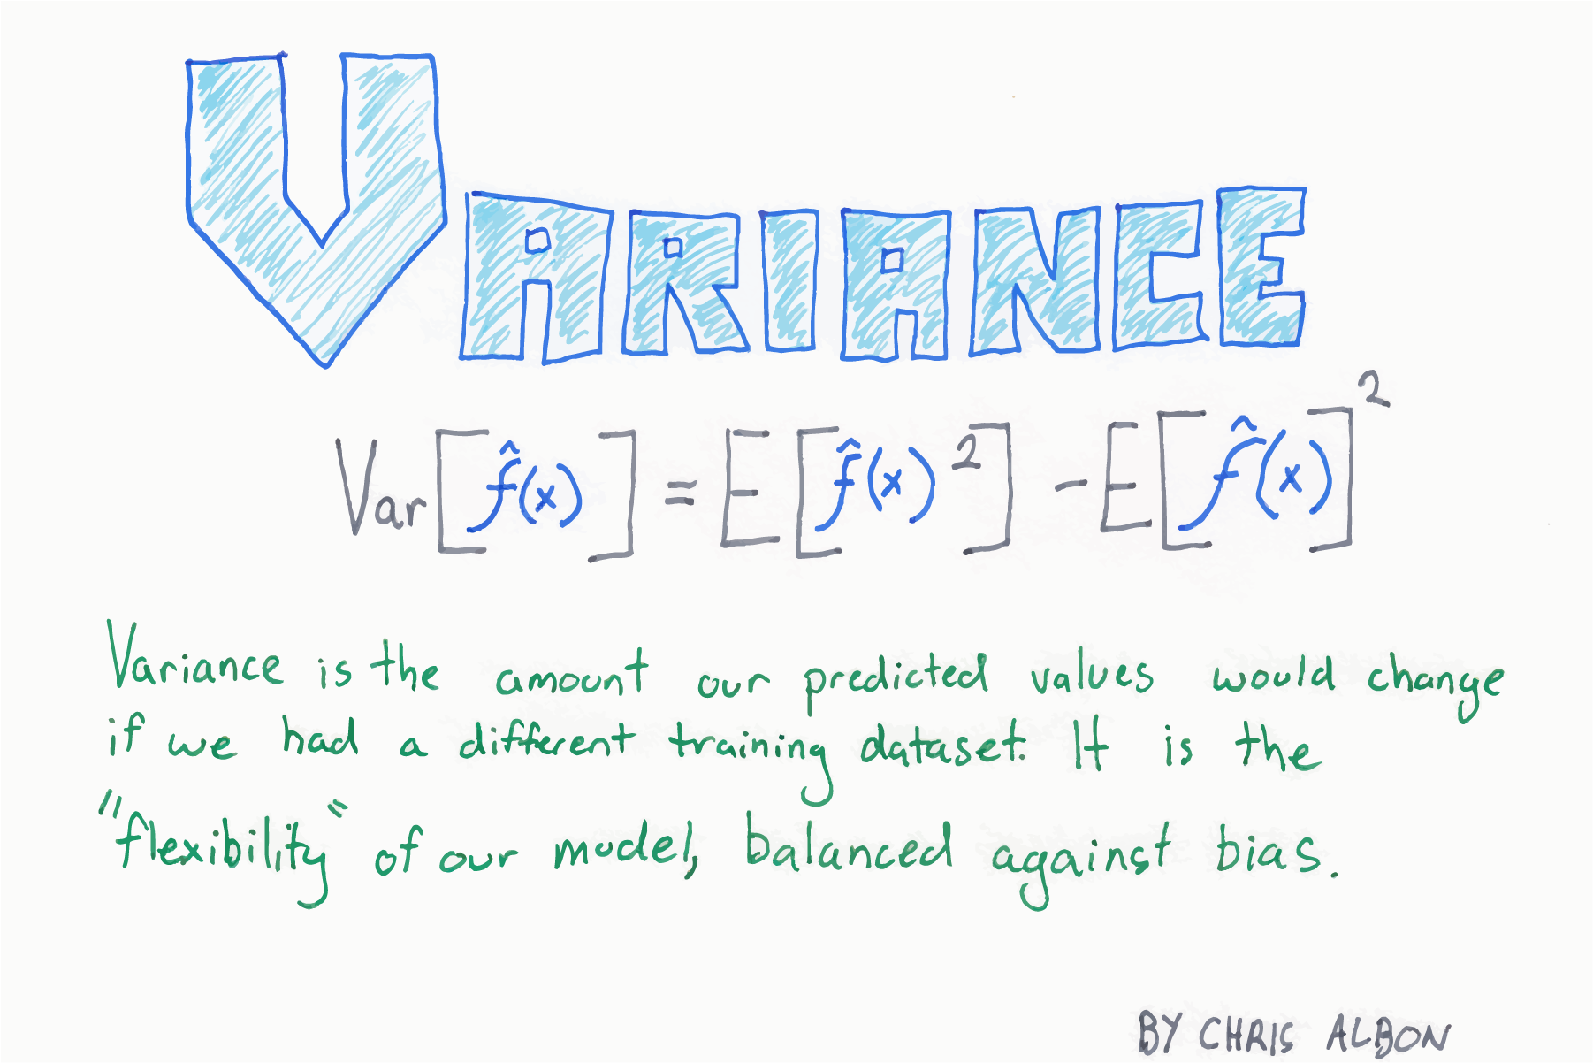
Recap: Bias-Variance Tradeoff

Slide 13
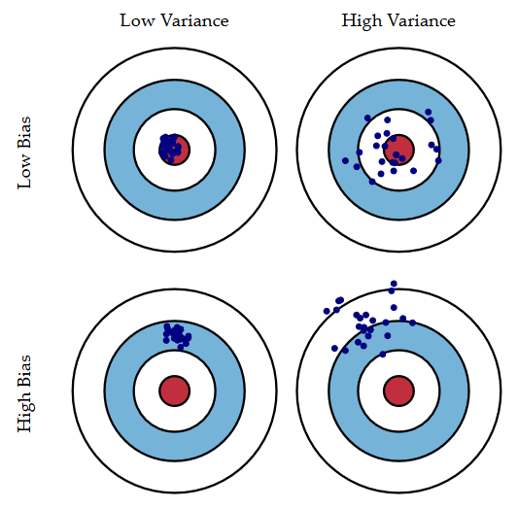
Recap: Bias-Variance Tradeoff
Credit: Scott Fortmann-Roe

Slide 14

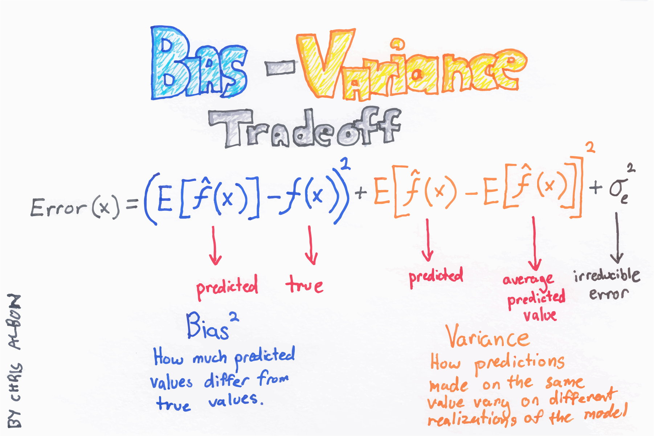
Recap: Bias-Variance Tradeoff
Credit: Scott Fortmann-Roe
Credit: Chris Albon

Slide 15
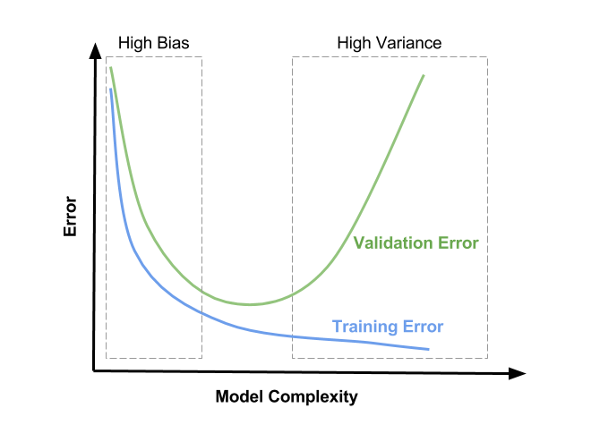
Recap: Diagnosing High Bias/Variance
Credit: Satya Mallick

Slide 16
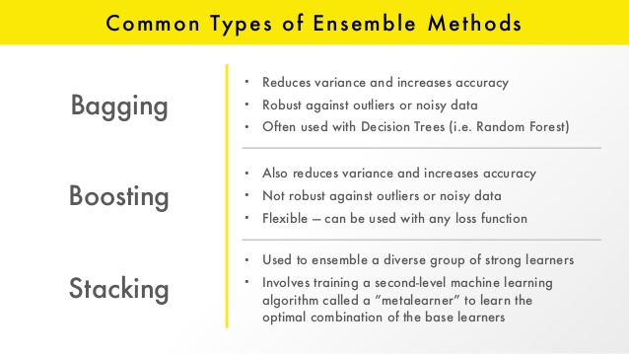
Credit: Erin LeDell

Slide 17
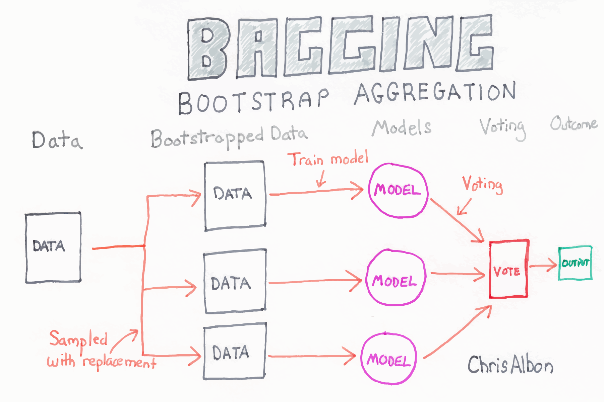

Slide 18
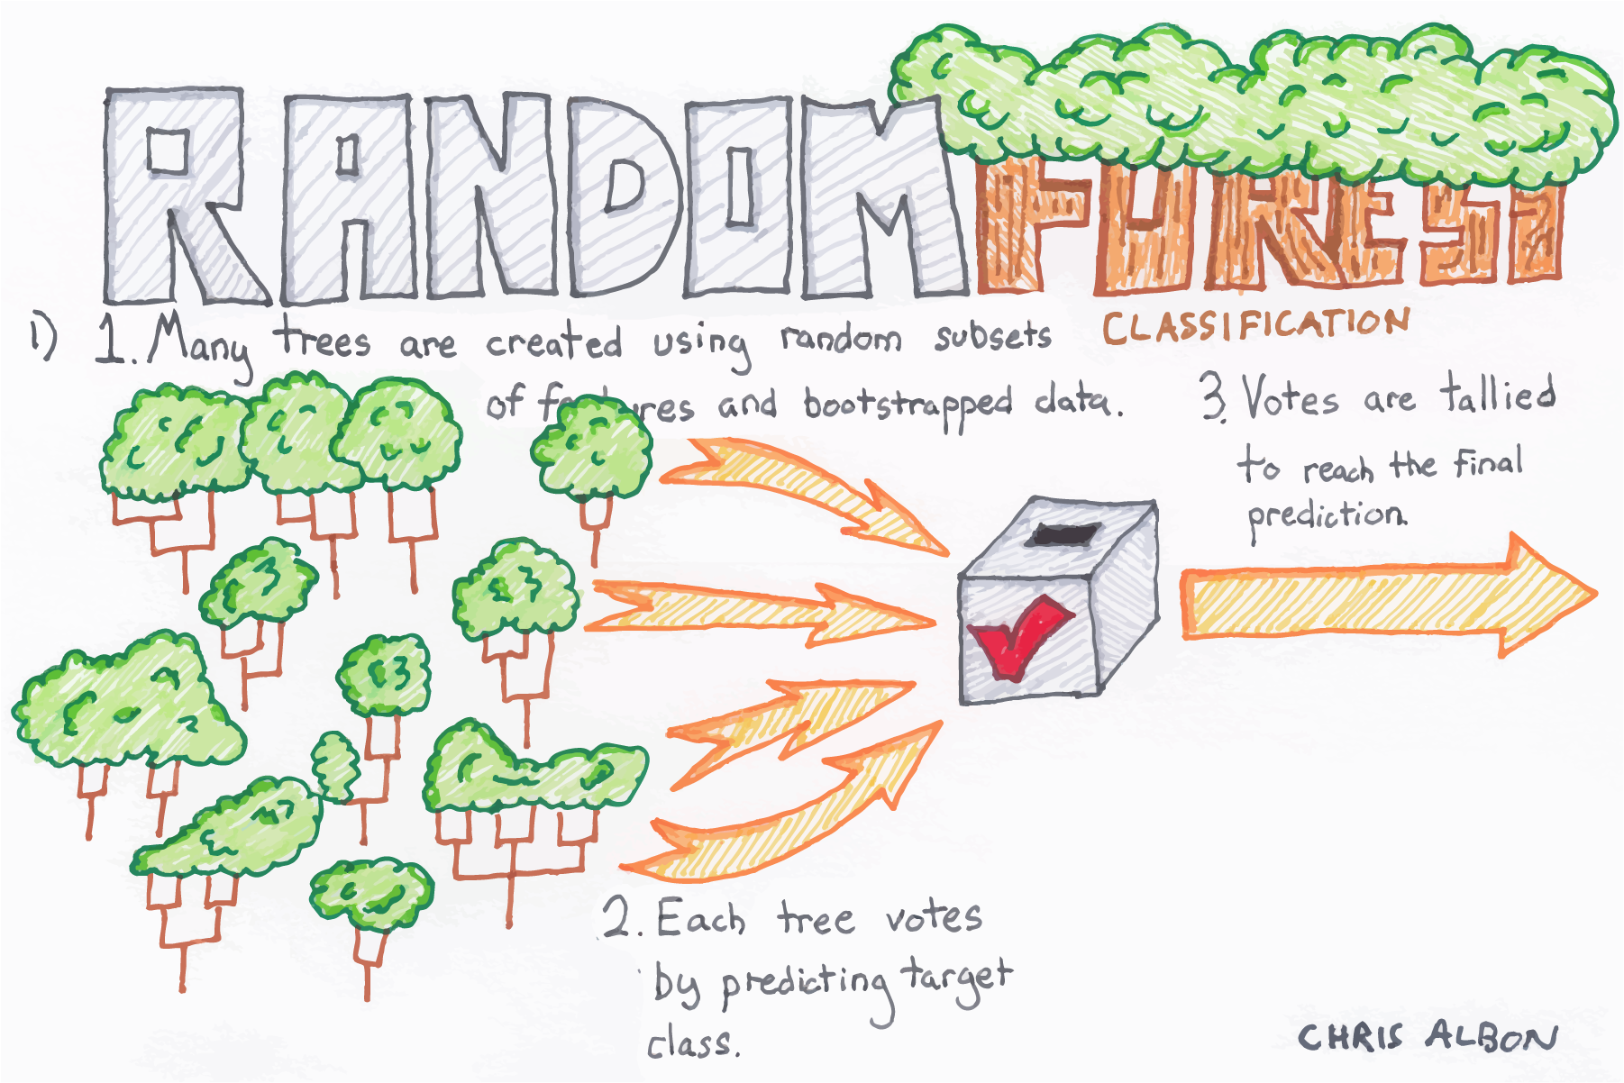

Slide 19
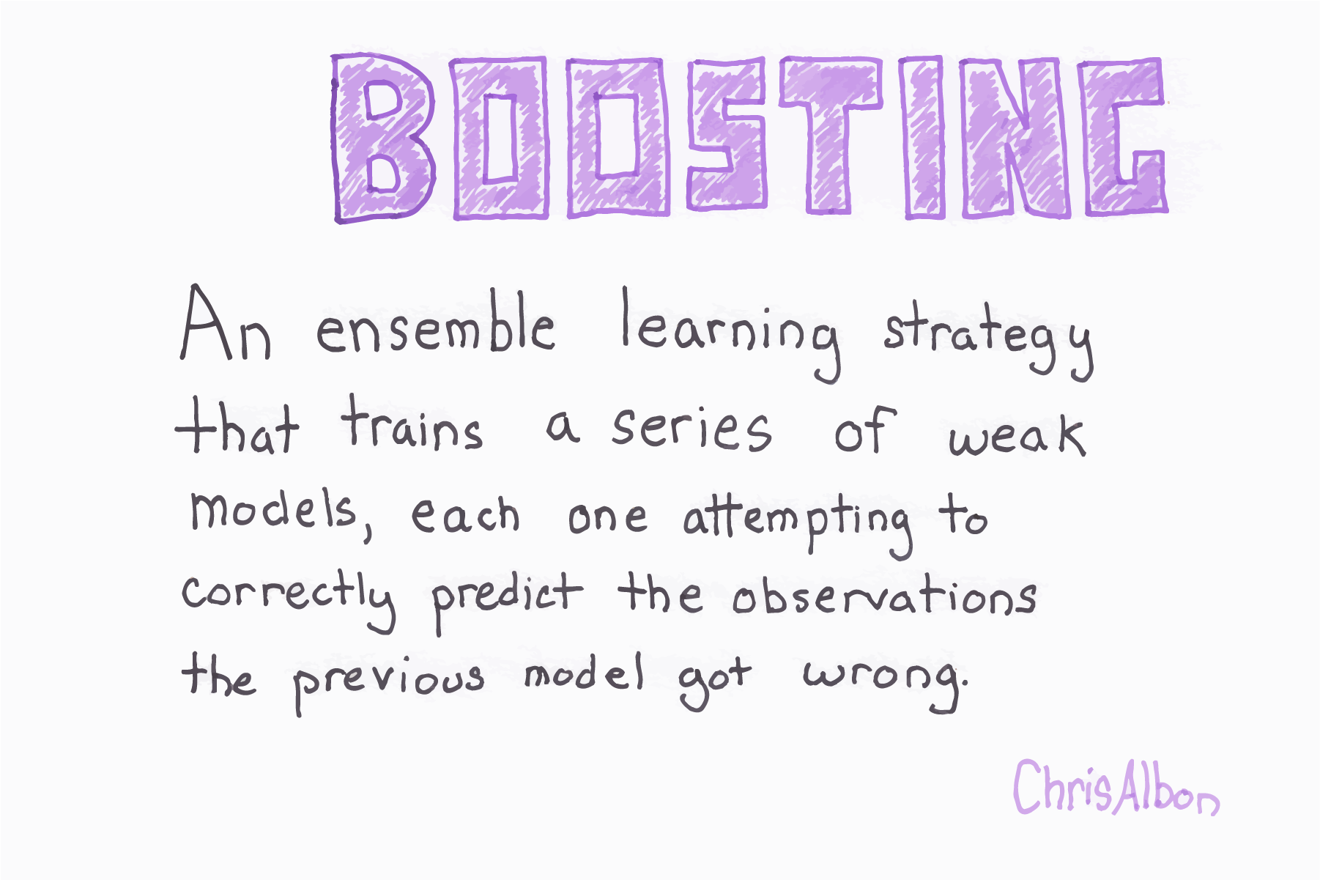

Slide 20
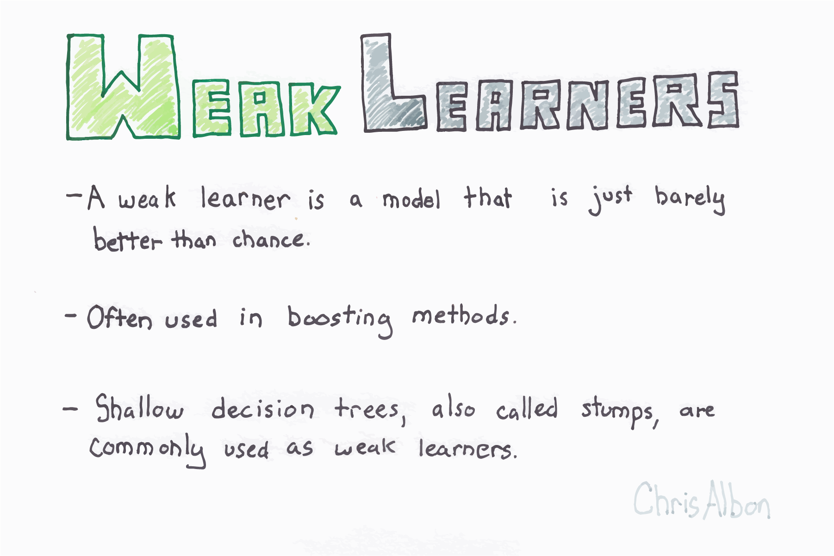

Slide 21
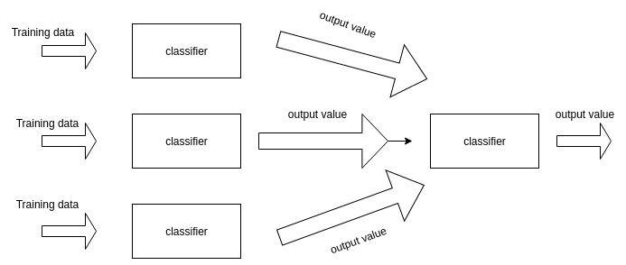
Stacking

Slide 22
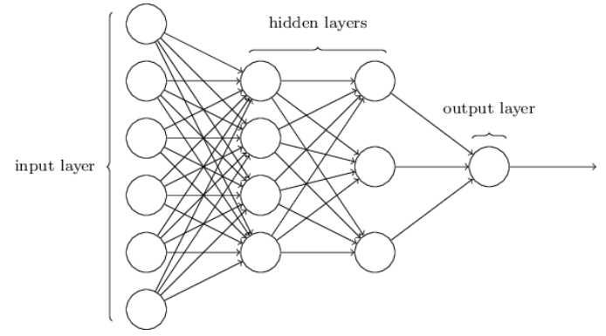
Why does that look familiar?
Neural Networks learn features from the data and have a final classifier
Stacking learns the optimal combination of base models for predictions

Slide 23
Popular Ensemble Algorithms
Bagging
Random Forests
Boosting
Gradient Boosted Trees
AdaBoost (Adaptive Boosting)

Slide 24




Popular Ensemble Frameworks (in Python)

Slide 25

Notebook Walkthrough
Notebook available at
www.github.com/JeffMacaluso/Talks/blahblahblah

